Slide 1


December 8-10 | Virtual Event
Reverse Engineering
of Rocket-Chip

Slide 2
December 8-10 | Virtual Event
Reverse Engineering of Rocket-Chip
Dr Roomi Naqvi
Director
MERL-PAKISTAN
#RISCVSUMMIT

Slide 3
To be covered
Goals
To decrease complexity of Rocket-Chip
Extend to add Vector extension.
Complexity of Task
Number of Modules, functions, Number of lines, objects etc
Scala Vs Chisel
Software Methodology
UML – Class diagrams
Class diagrams to State diagrams
Software spec to Micro-architecture spec
Block
Shows how the methodology was employed
Future Research
Parameterize-able Micro-Architecture
Parameterize-able I/O interface

Slide 4

Motivation and Scope
Explain the workflow to a beginner seeking to understand and use Rocket-core for generating a customized System on chip (SoC) or modifying a module based on their general requirements.
Provide a hardware view by mapping it to blocks of code which highlights the wiring and back tracing of input/output by means of variables. The hardware mapping creates a linkage between software and hardware in entire workflow.
The Microarchitecture Specification (MAS) Documentation designed by MERL-UIT aims to achieve an elaboration of Rocket-chip at core level and its components in a detailed manner, it furthermore features additional representations such as block diagrams and flowcharts.

Slide 5
Methodology
We decode basic modules of rocket chip by taking understanding of its code line by line with the help of Scala and Chisel expertise.
We convert these modules code understanding into flow charts and start making Micro Architecture Specification (MAS) documentation.
We make flow charts for different modules of Rocket Chip. After completion of flow charts, we make block diagrams of Rocket Chip modules according to its configuration pin in and out

Slide 6
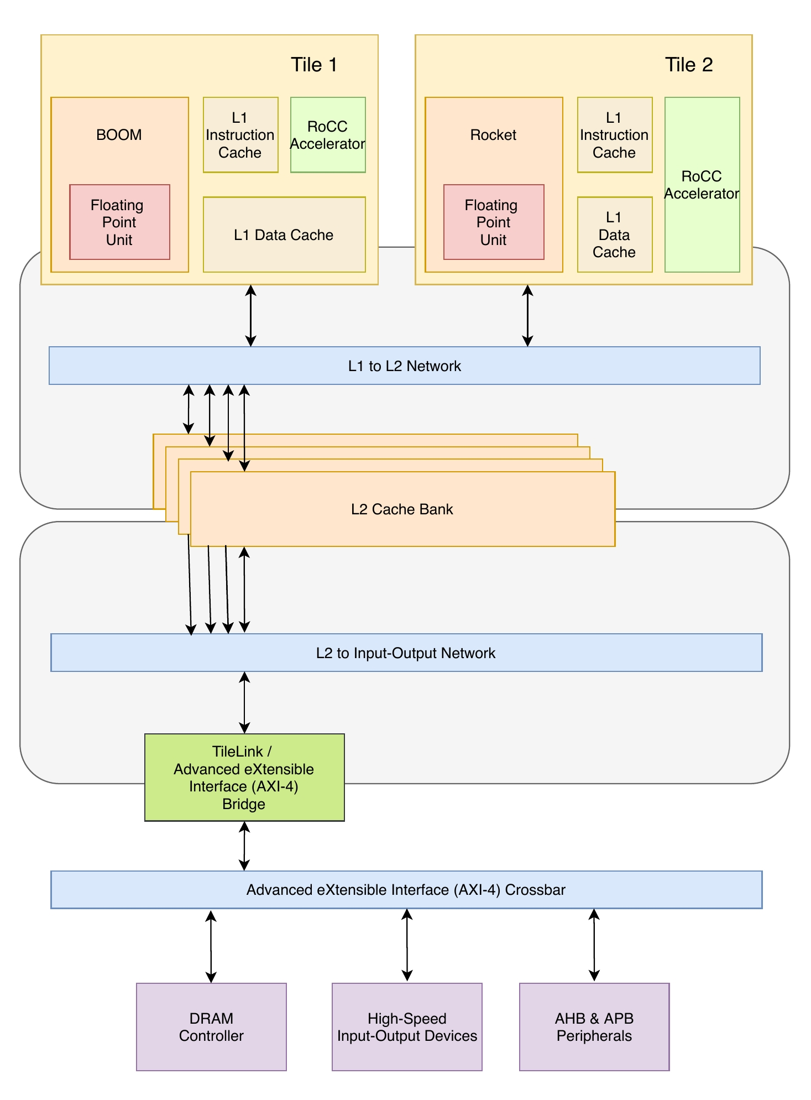
ROCKET-CHIP Overview
Rocket chip is a chip generator that is used for generating a multi-core system with Rocket scalar cores, Z-Scale control processors, and a coherent memory system.
Rocket chip generator is written in a Scala that uses Chisel compiler to emit a full SOC descriptive RTL.
The configuration of SOC are specified through Chisel parameters.

Slide 7
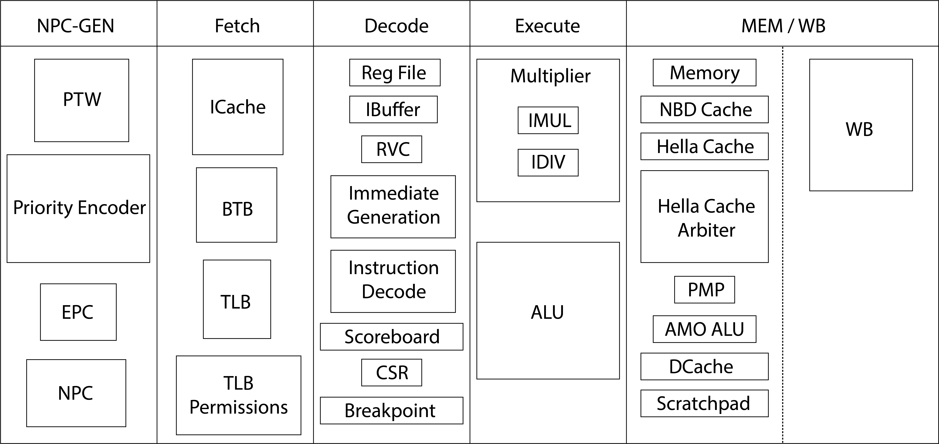
ROCKET-CHIP Micro-Architecture

Slide 8
Code Complexity
The complexity of code of Rocket-chip is high, because it contains 372 files in 73 directories, after the submodules the numbers increase to 151,613 files in 8,625 directories and after running the build script to generate an SoC the numbers grow to 185,049 files in 10,780 directories¹.
Another issue faced was that Rocket-chip contains several meaningless variable names and non-elaborated comments which further leads to uncertainty in methods, increases the complexity to decode it and makes it tough to understand the hardware inputs/outputs.
Lack of understandability and comprehension concludes to difficulty in modifying Rocket-core or its component as for customized requirements.
¹ Durrum, J., Bryant, A. and Porter, J., 2019. Reverse Engineering RISC-V Generator-Based Designs for Trust and Assurance. AFRL/RYDT WPAFB United States.

Slide 9
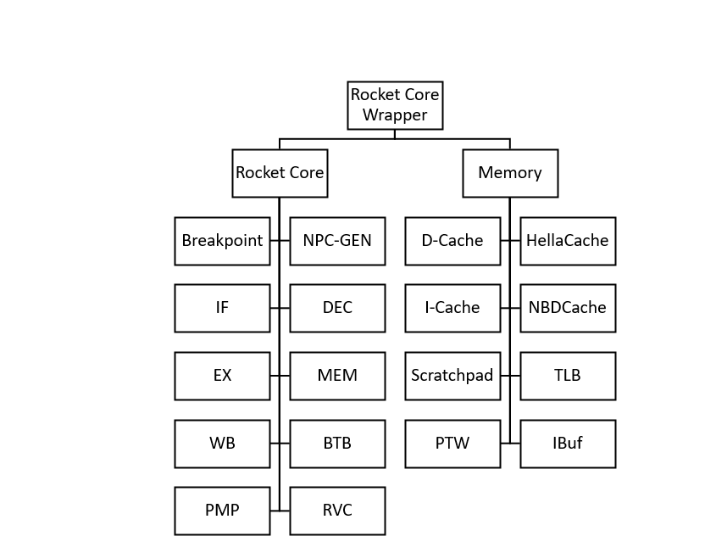
Rocket Core Hierarchy

Slide 10
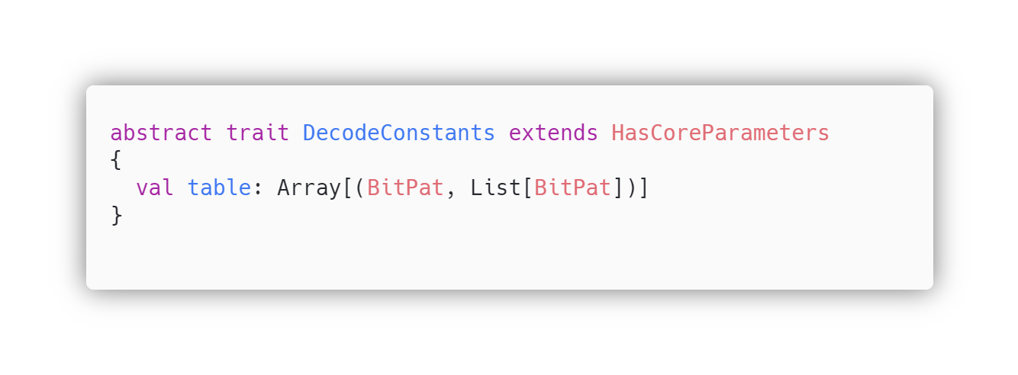
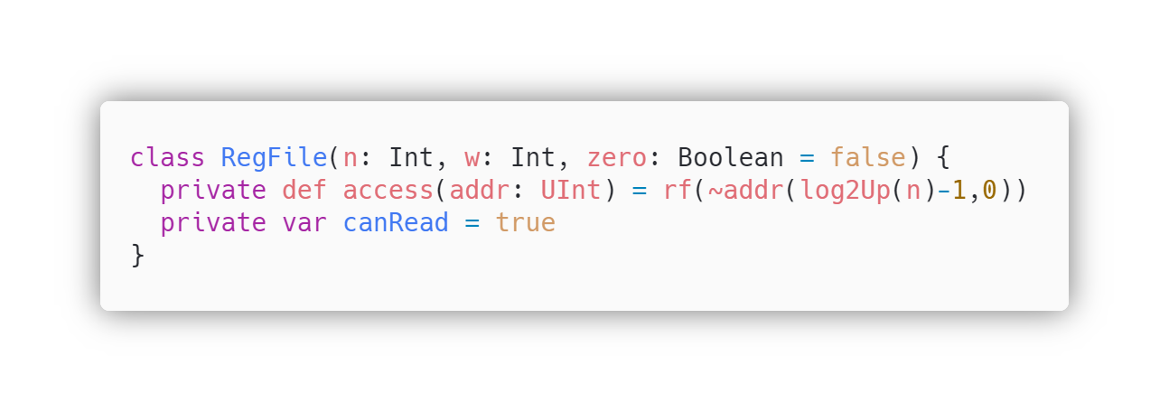
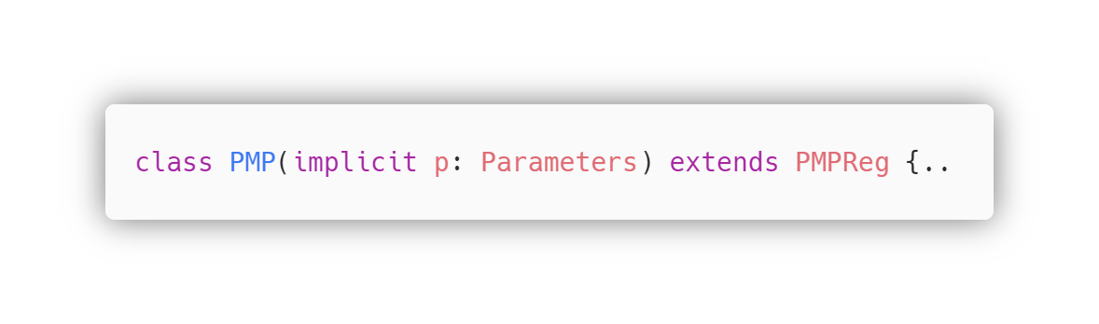
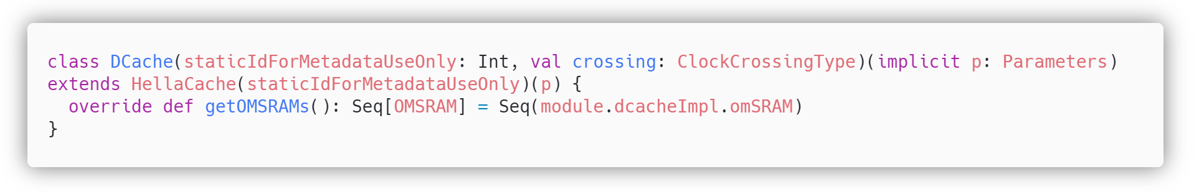
Object Oriented Code of Rocket-Chip
Abstraction
Abstraction is achieved by abstract keyword, creating an abstract trait of DecodeConstants
Encapsulation
Private access modifier is used to encapsulate/hide method ‘access’ from other extended classes
Inheritance
Keyword extend is used to extend/inherit the PMP class with parent class PMPReg
Polymorphism
Keyword override is used to override method getOMSRAMs, which is already defined in the parent class.

Slide 11
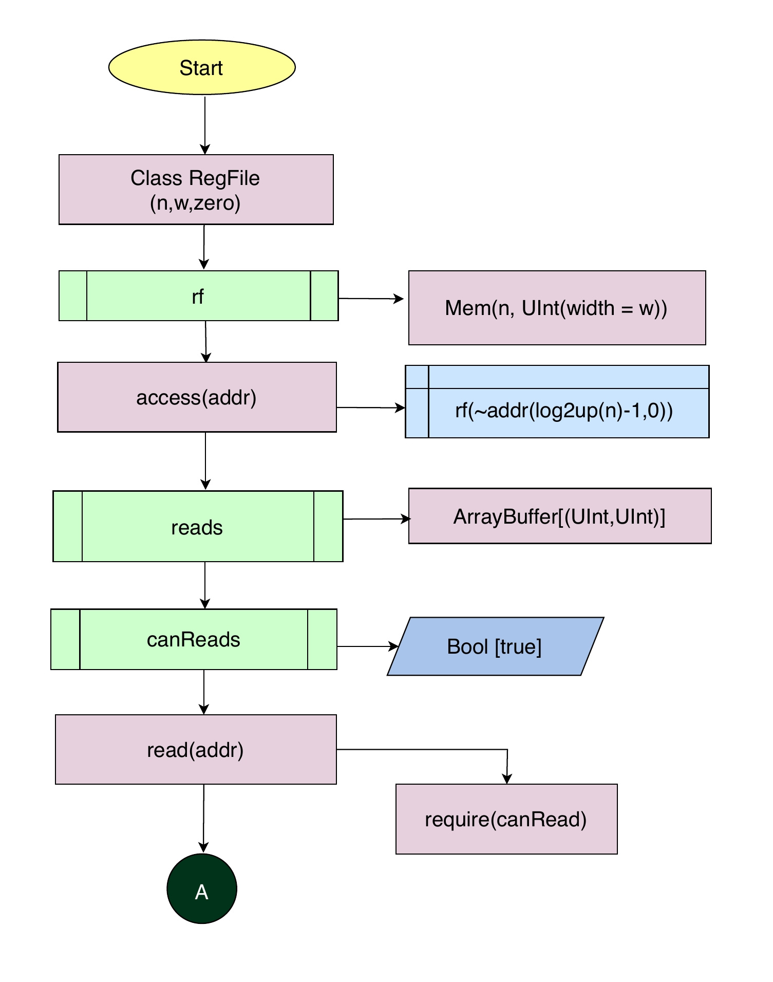
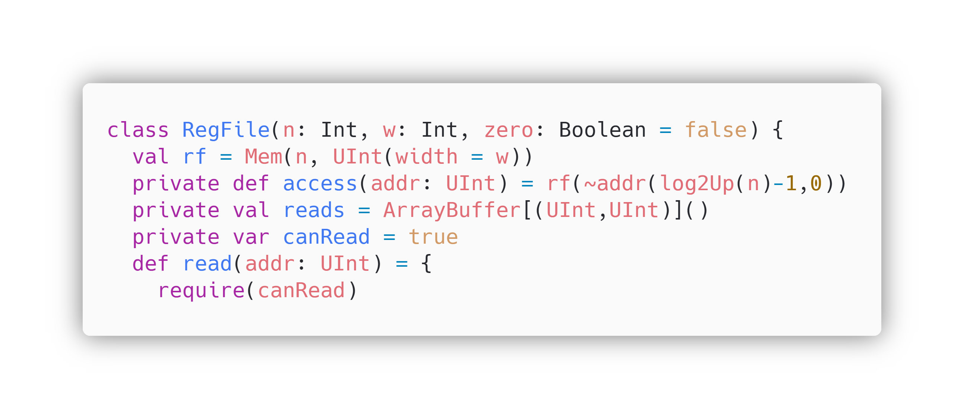
Code Explanation and Back-tracing
via Flowcharts and Block Diagram
Class RegFile is initiated with three parameters n, w and zero having type Int and Bool
This class creates register file of rocket chip
Mem function is used to create memory where n= depth/entries of memory and w= width of memory.
In the RegFile class, a method named access is defined for accessing the register file data by taking the address as its input parameter.
Variable reads calculates the address which will be used to read the data
Variable canRead is defined as true for read state
For write state canRead will be false.
Method named ‘read is defined in class RegFile to read data from register file. It takes addr as parameter

Slide 12
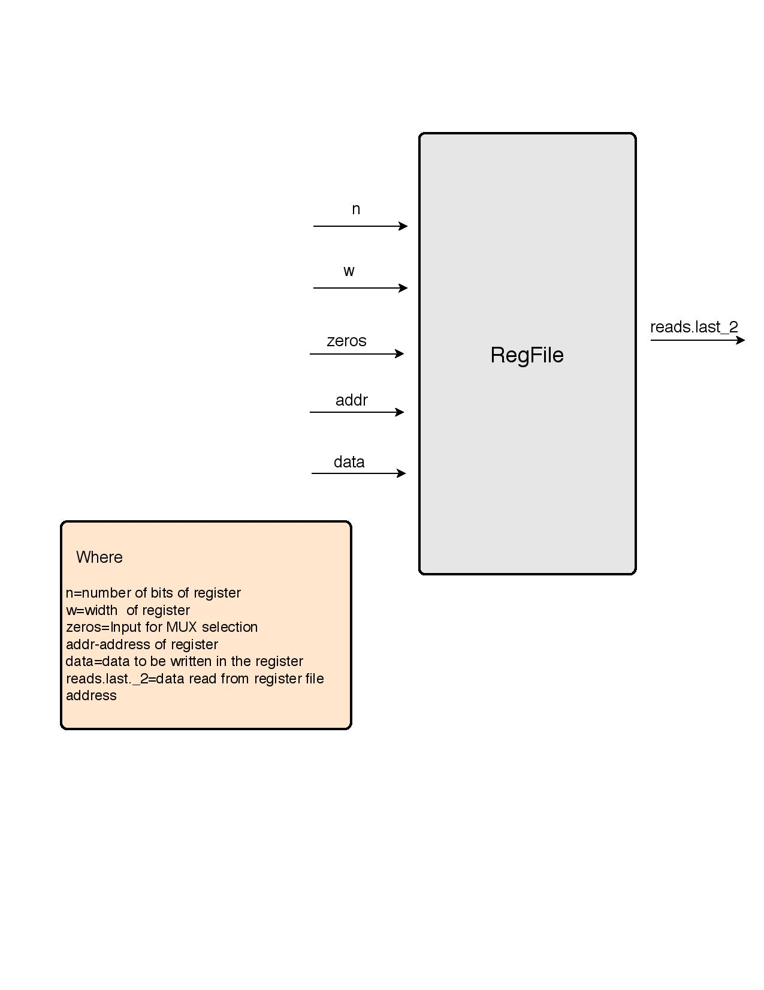
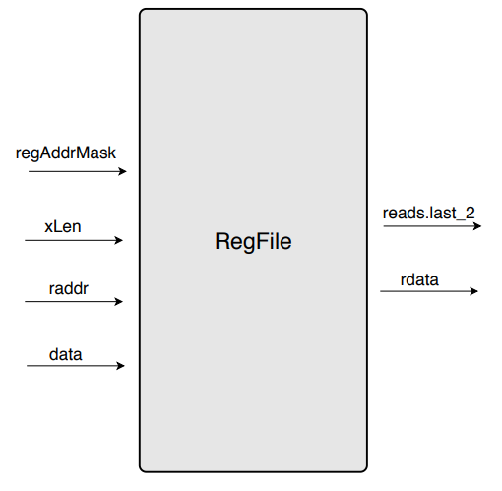
regAddrMask = depth/entry of register file memory = 2^{XLen} -1
reads.lasts._2 = data read from register file address [0:31] / [0:63]
xLen = width of registers [0:31] / [0:63]
zeros = selection bit for read/write operation [Bool]
raddr = address of register [0:4]
data = data to be written in the register [0:31] / [0:63]
rdata = data output from register file [0:31] / [0:63]

Slide 13
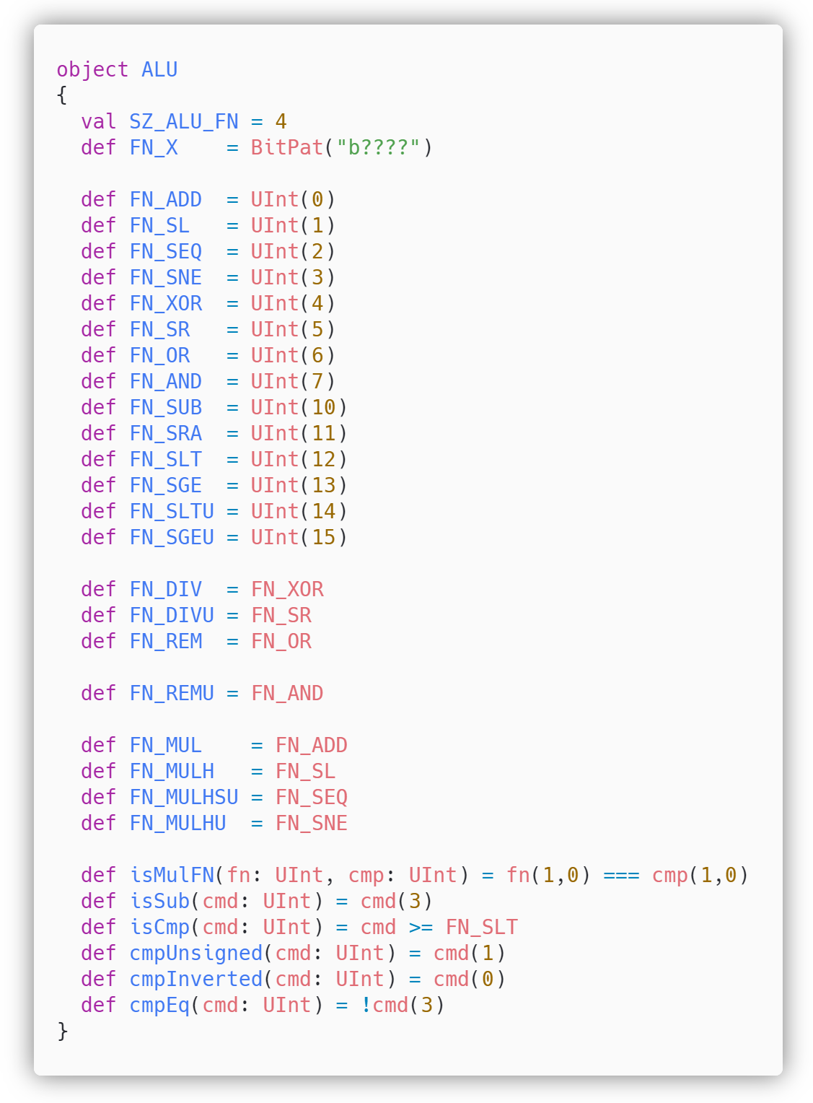
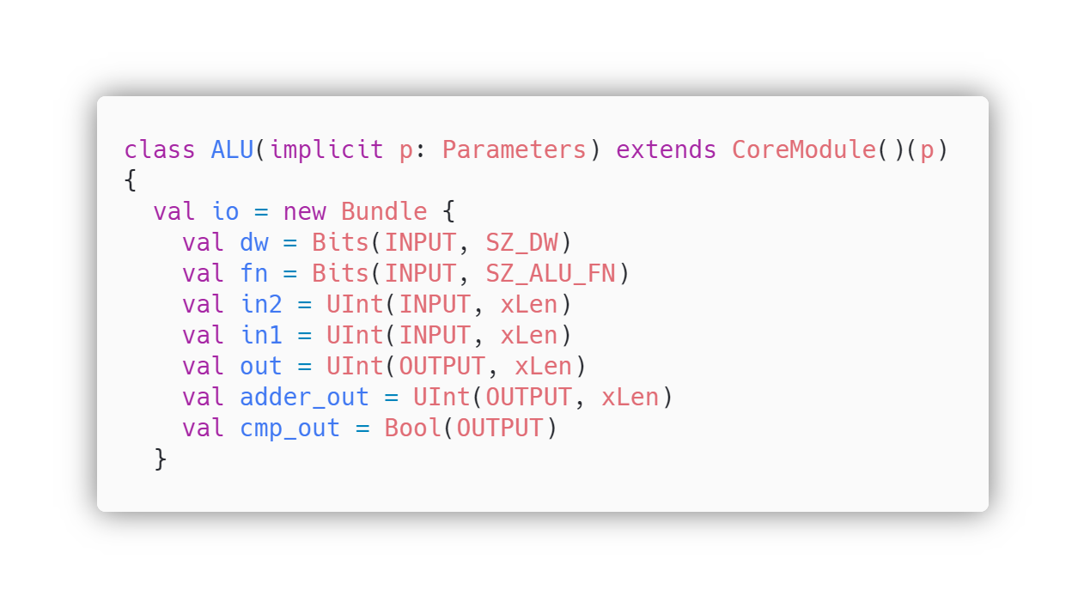
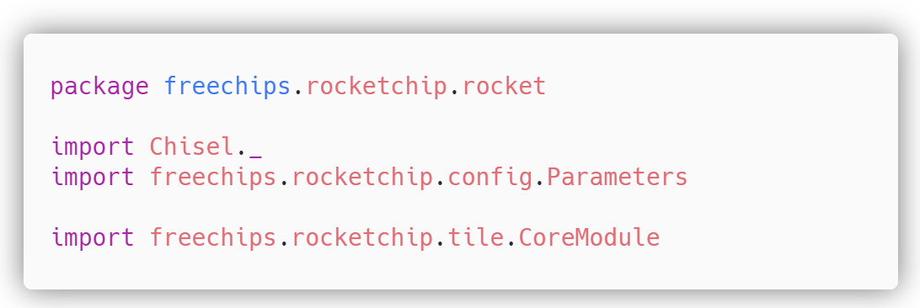
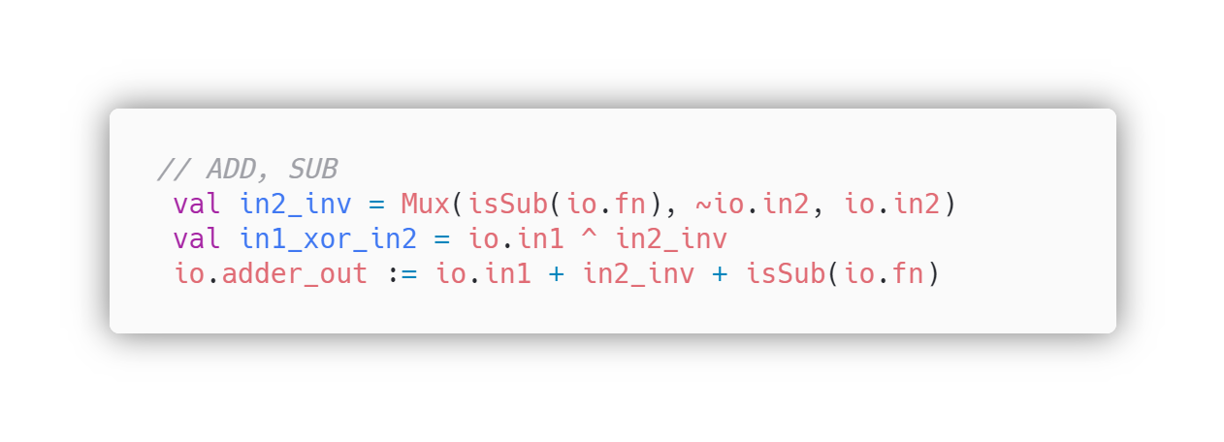
Object ALU is defined
ALU operation bits are defined in method FN_X
ALU operations are defined
Input-Output of class ALU are defined
Class Parameters is imported from directory config of rocket-chip
Class CoreModule is imported from directory tile of rocket-chip

Slide 14
Deep Dive into Rocket-ALU
Class ALU has three inputs and three outputs
ALU I/O | Description
dw | Data width which can be 32bit or 64 bit
fn | Takes Aluop bits as input, width is predefined by 4
in2 | Operand B input, here xLen can be changed to 32 or 64bits
in1 | Operand A input, here xLen can be changed to 32 or 64bits
out | It is the ALU result output for logical operators, generated by the ALU
adder_out | It is the ALU result output for mathematical operators, generated by the ALU
cmp_out | Branch output weather branch condition True or False

Slide 15
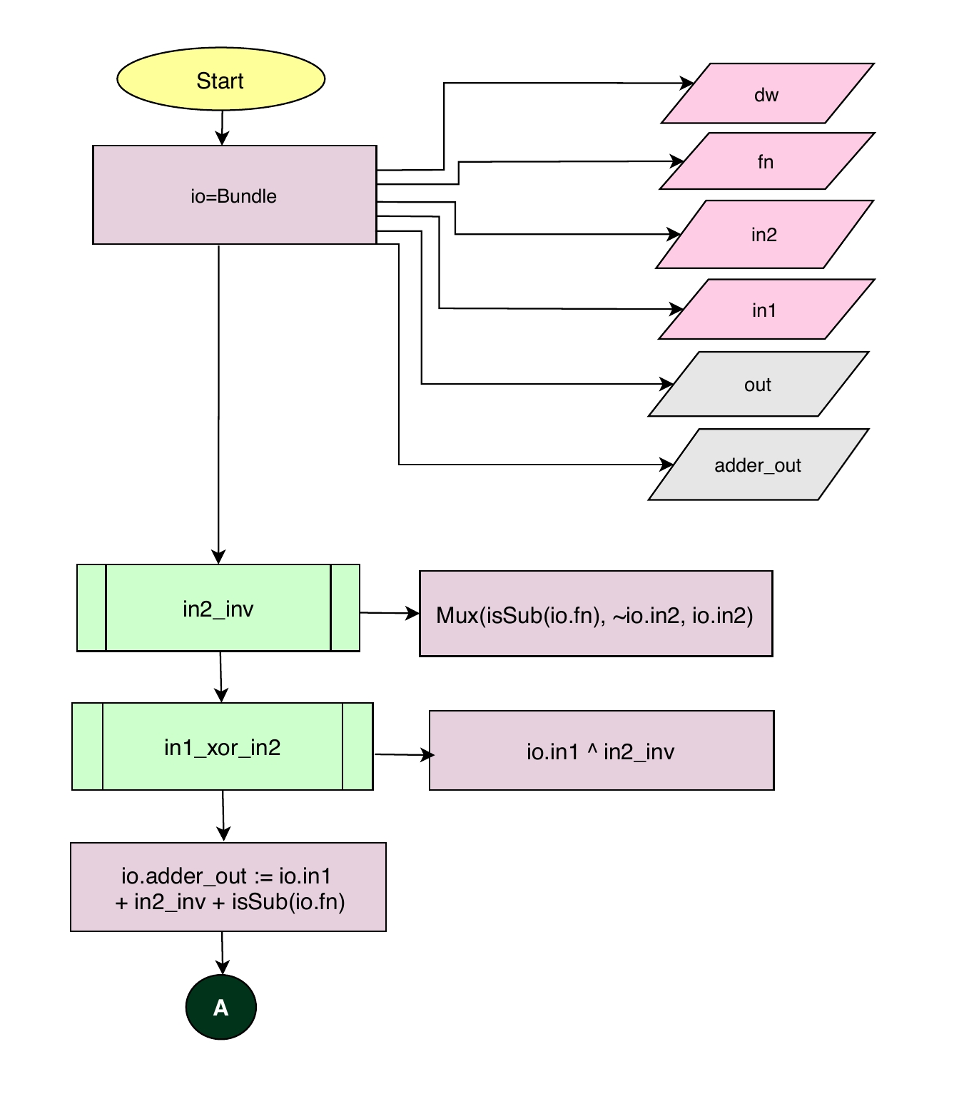
The Next block of code performs addition and subtraction operation of ALU.
adder_out is used to output the result of addition / subtraction operation performed by ALU
Variable in2_inv is initialized with Mux function which has parameters, isSub function with parameter io.fn as selector, Not of io.in2 as input1 of Mux, and io.in2 as input2 of Mux
Variable in1_xor_in2 is initialized with io.in1 XOR’ed ( ^ ) with in2_inv.
Io.adder_out is wired to io.in1 + in2_inv + isSub of io.fn

Slide 16
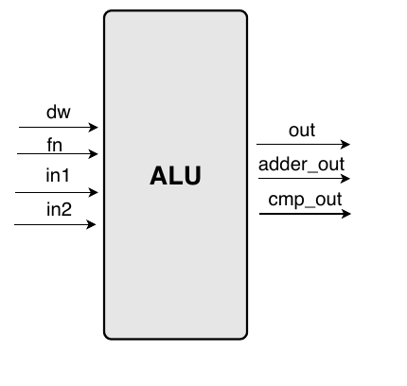
dw = datawidth [0:31]/[0:63]
out = ALU result output for logical operators [0:31]/[0:63]
fn = ALUop bit as input [0:3]
In1 = Operand B of ALU as input [0:31]/[0:63]
In2 = Operand A of ALU as input [0:31]/[0:63]
adder_out = ALU result output for mathematical operations [0:31]/[0:63]
Cmp_out = Branch result output [Bool]

Slide 17
Rocket Core MAS Documentation
This MAS Document provides in depth understanding of Modules of Rocket-Chip SoC.
Explanation of Modules is achieved by means of Block Diagrams, Class Diagrams, Flowcharts, and explanation of all the keywords found in the code.
This MAS Document is essential for those who have basic knowledge of Scala, CHISEL and SoC hardware.
In explanation only the name of keywords is used but their definition is mentioned in the Appendix – Scala & CHISEL keywords.

Slide 18

Aghaz(آغاز) SoC The Beginning

Slide 19
Specifications of Aghaz(آغاز) SoC
RV-32 (32-bit)
I, M & C extensions
GPIO (General Purpose Input Output)
64-KB Instruction and Data Cache
CLINT
PLIC
Privileged( Machine)

Slide 20
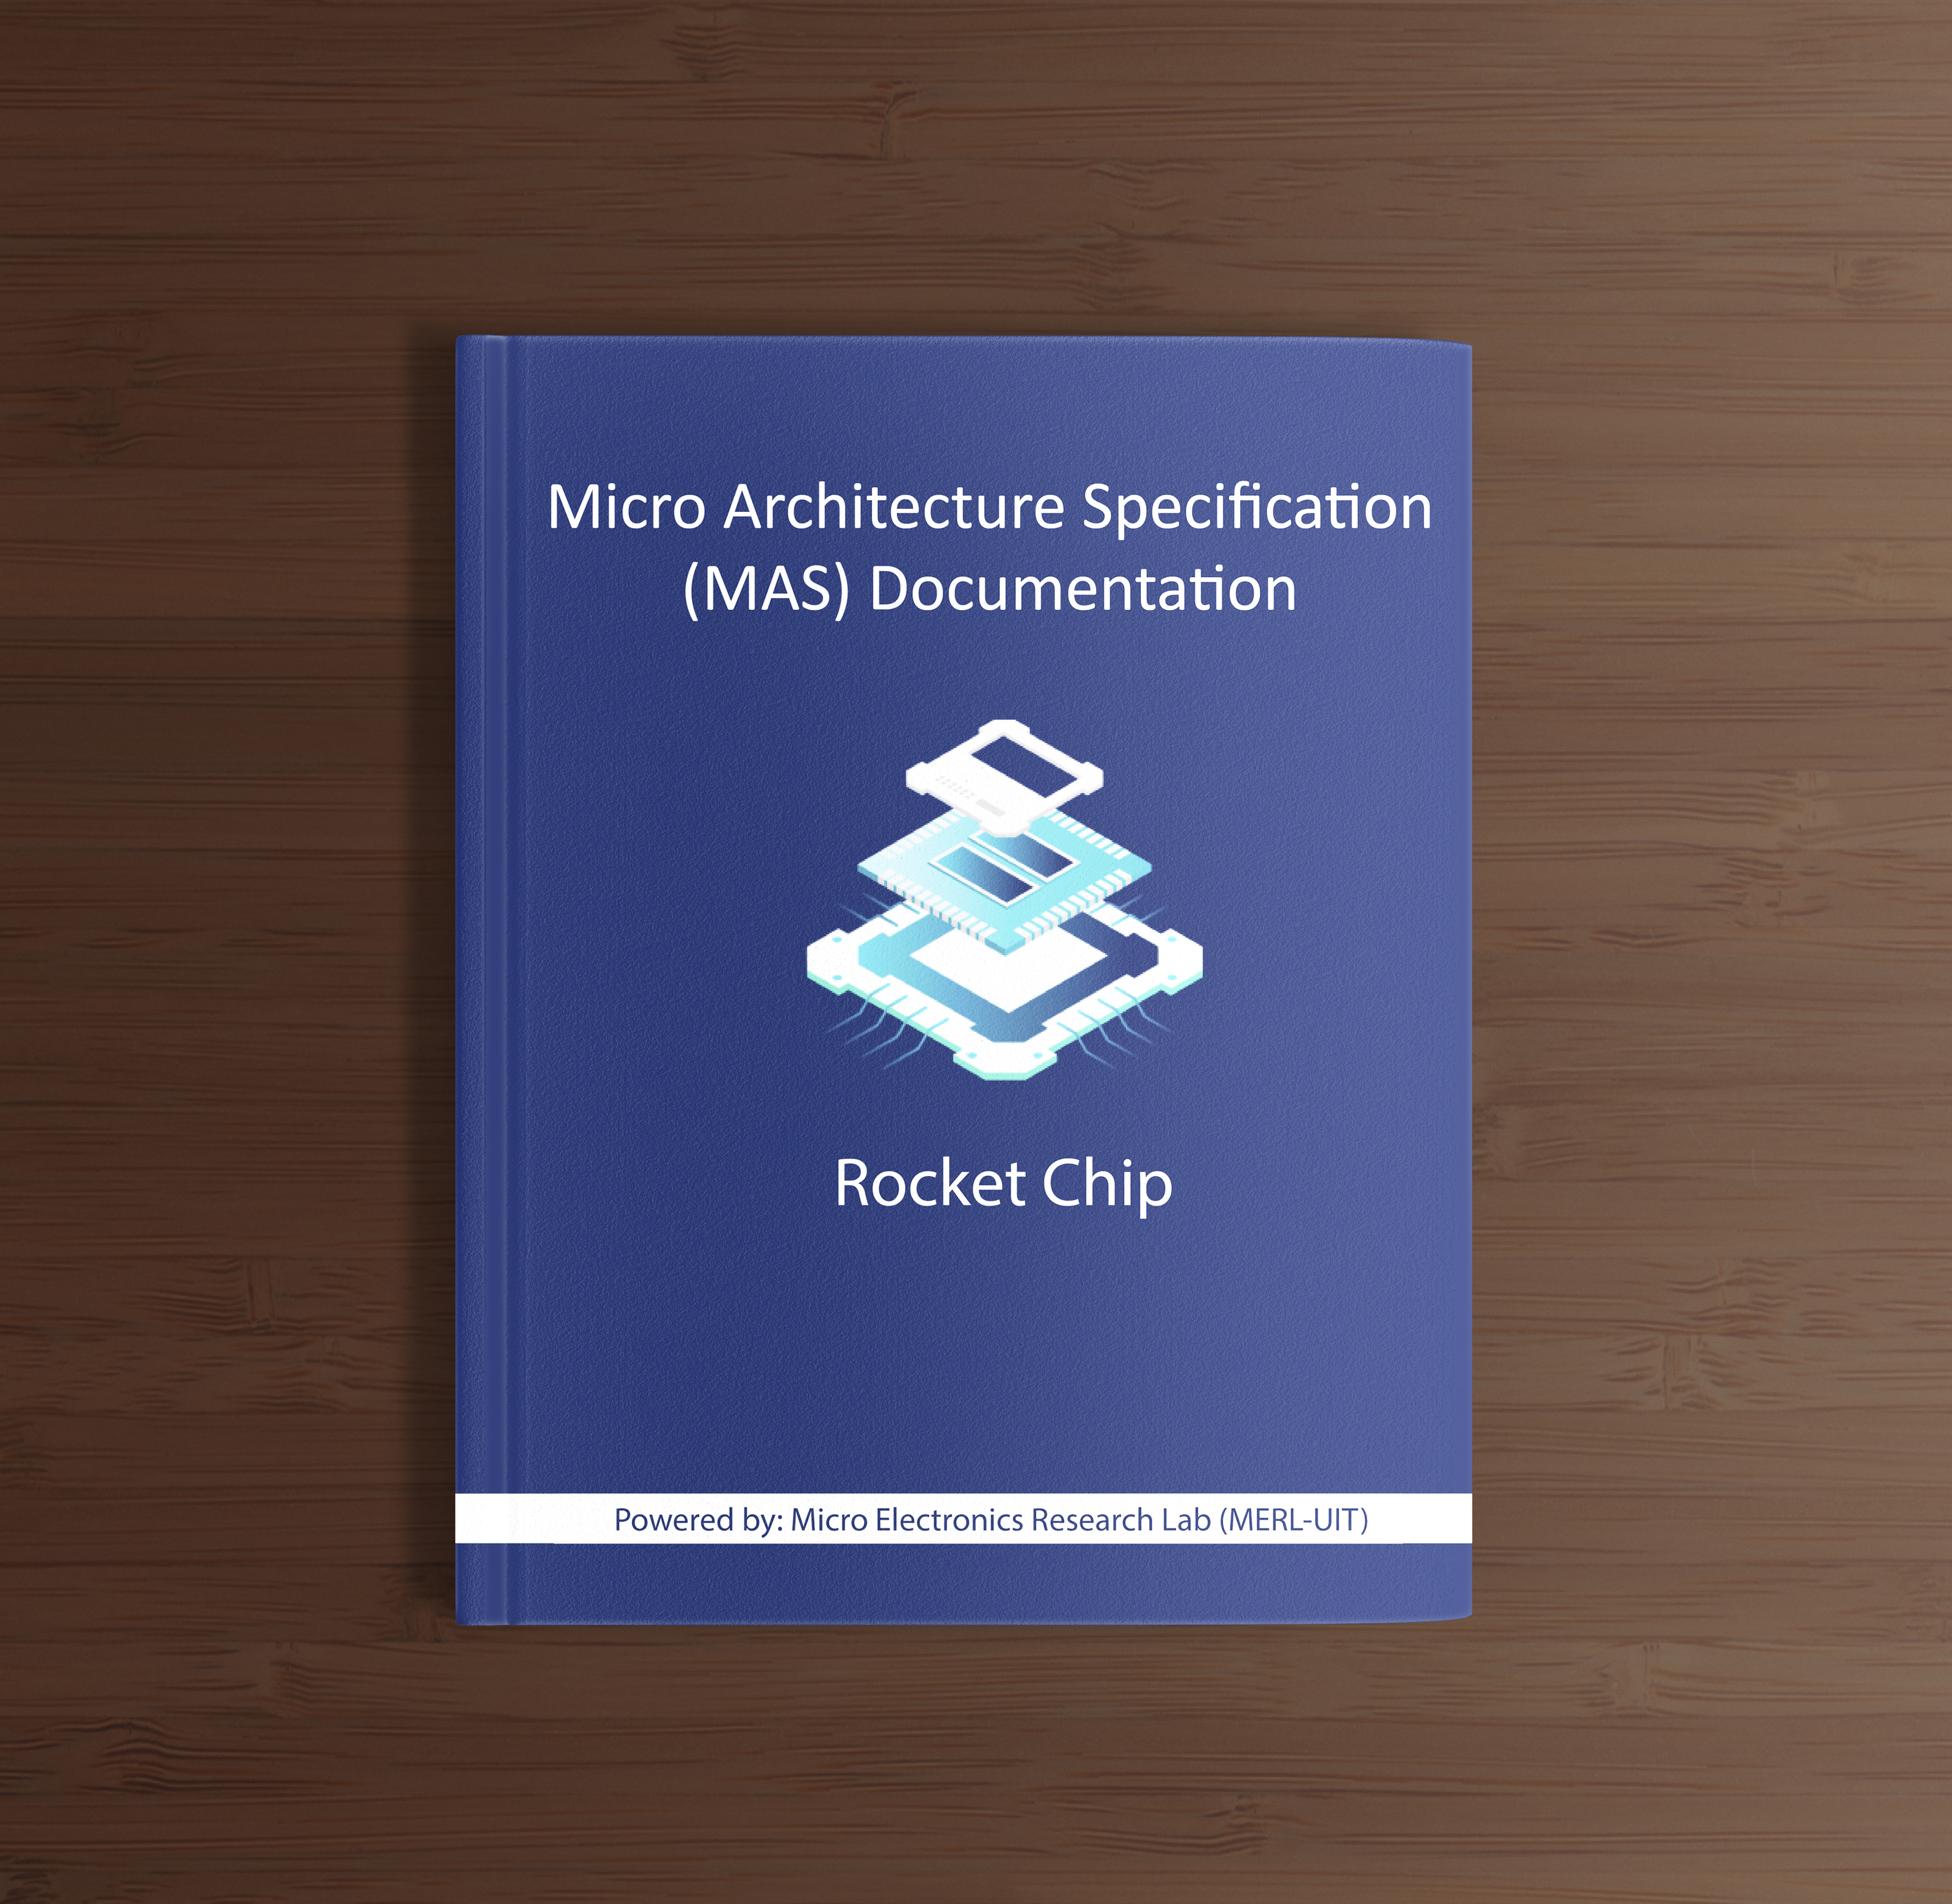
How did we do it?
By using Reverse Engineered MAS Document, which contains in-depth knowledge of all the Modules of Rocket-Chip generated by Rocket-Chip SoC Generator

Slide 21
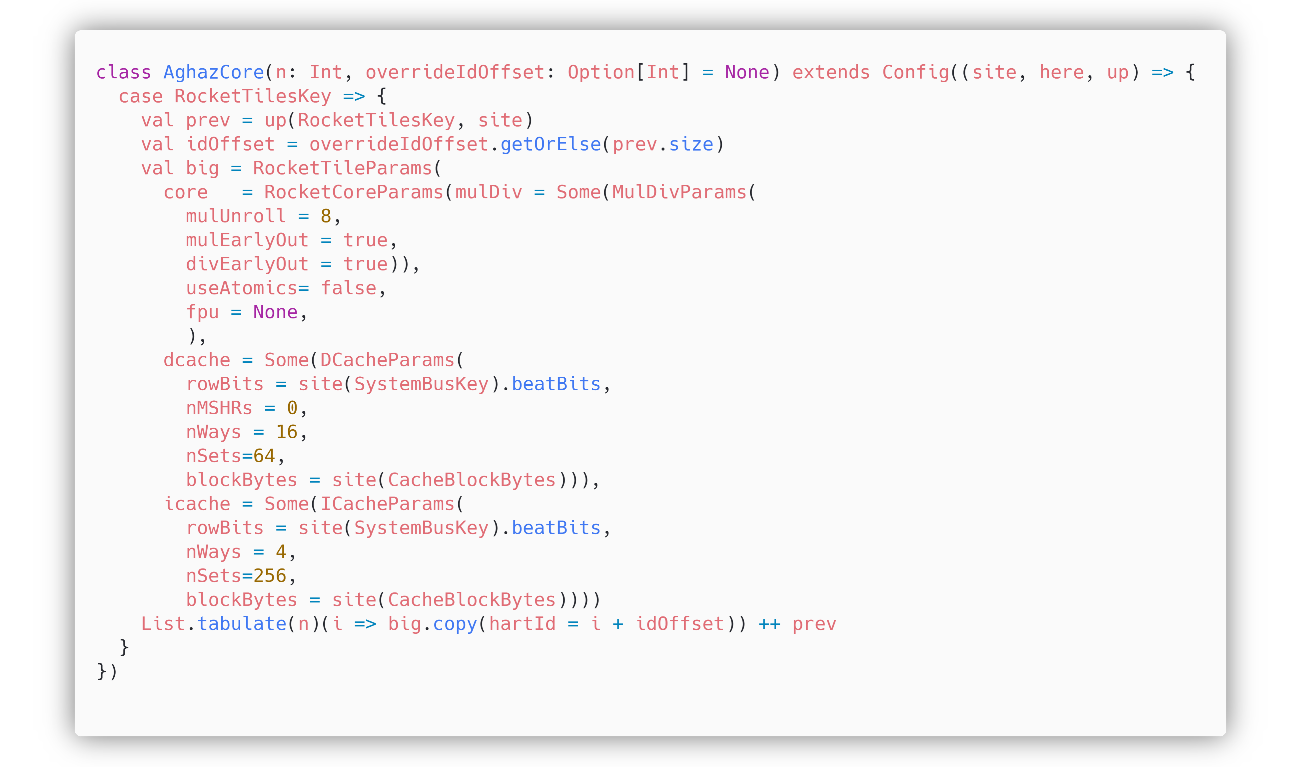
Adding Custom Configuration in Rocket-Chip
Rocket Core parameters
Data Cache parameters
Instruction Cache parameters

Slide 22
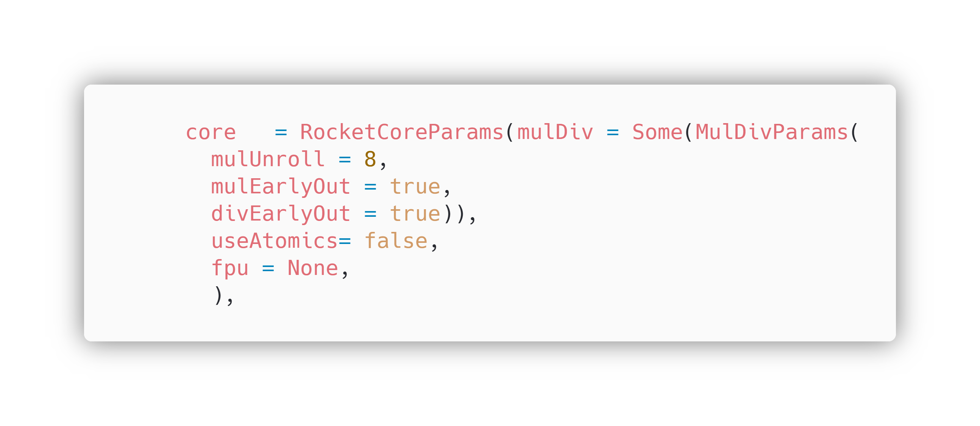
Configuring only the Core

Slide 23
Configured Parameters
Parameters | Value | Description
mulDiv | mulDivParams | mulDiv is the Multiplier, enabling the M-extension, having mulDivParams, that are parameters to configure the Multiplier.
useAtomics | false | useAtomics parameters is for A-extension, giving it a false value will disable the A-extension
fpu | None | fpu is the Floating Point Unit, giving it a None value, will disable F and D extensions.
Default Parameters
useCompressed | true | useCompressed is for C-extension, it is true by default, means our Core will have C-extension enabled implicitly.

Slide 24
Configuring only the Core
RocketCoreParams has the parameters for configuring our Core.
We added MulDiv(Multiplier) with MulDivParmas, having default values, in the RocketCoreParams, in order to enable M extension in our Core.
The number of cycles per multiplication is roughly (xLen / mulUnroll).
If the multiplier isn't fully pipelined (i.e., mulUnroll < xLen), then mulEarlyOut will make the multiplier's latency data-dependent, i.e., it'll take fewer cycles to multiply small numbers than large ones.
We updated the value of useAtomics to false, to disable A extension, and updated fpu(Floating= Point unit) to None, to disable F and D extensions in our core.
divEarlyOut is analogous to mulEarlyOut (smaller numbers divide more quickly than larger ones).

Slide 25
Rocket Core Params (Core)
In the RocketCoreParams, useCompressed is true, means C extension is enabled by default.
I extension is the base Extension and is also enabled by default.
Hence, our core is configured to support I, M and C Extensions.
useCompressed | true | useCompressed is for C-extension, it is true by default, means our Core will have C-extension enabled implicitly.

Slide 26
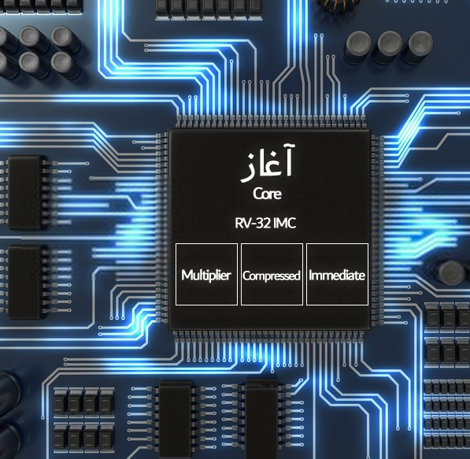
Blocks of Core
Aghaz Core contains, I, M and C extensions, with 32-bit compatibility.

Slide 27
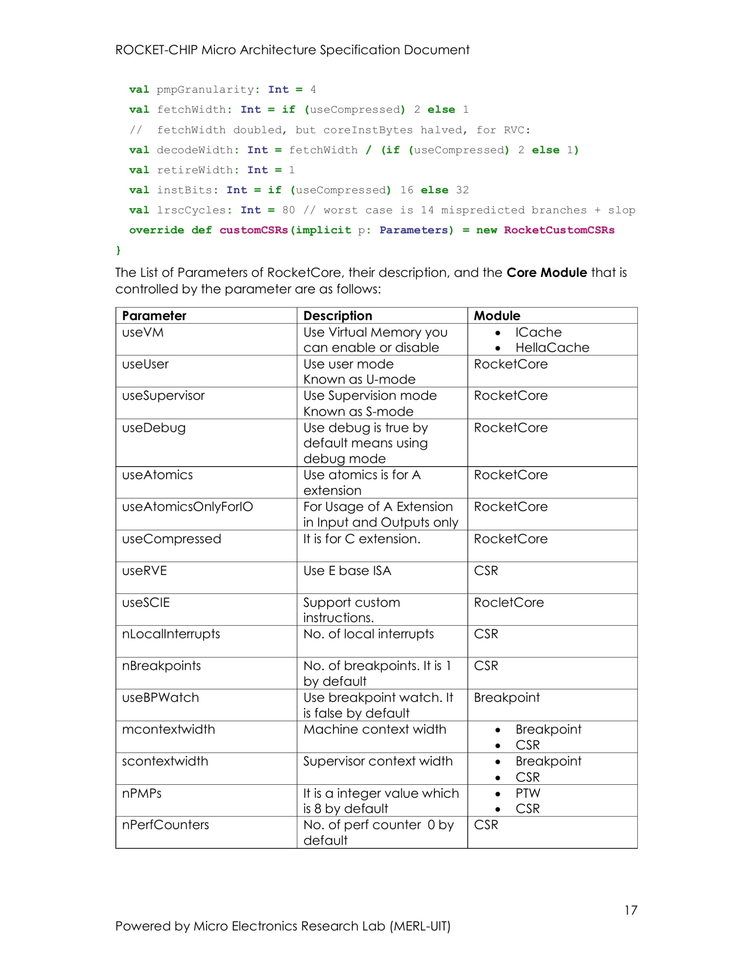
How did we know, which parameter is doing what?
The Parameters, their description and the modules which is controlled by that parameter is mentioned in the MAS Document in this way.

Slide 28
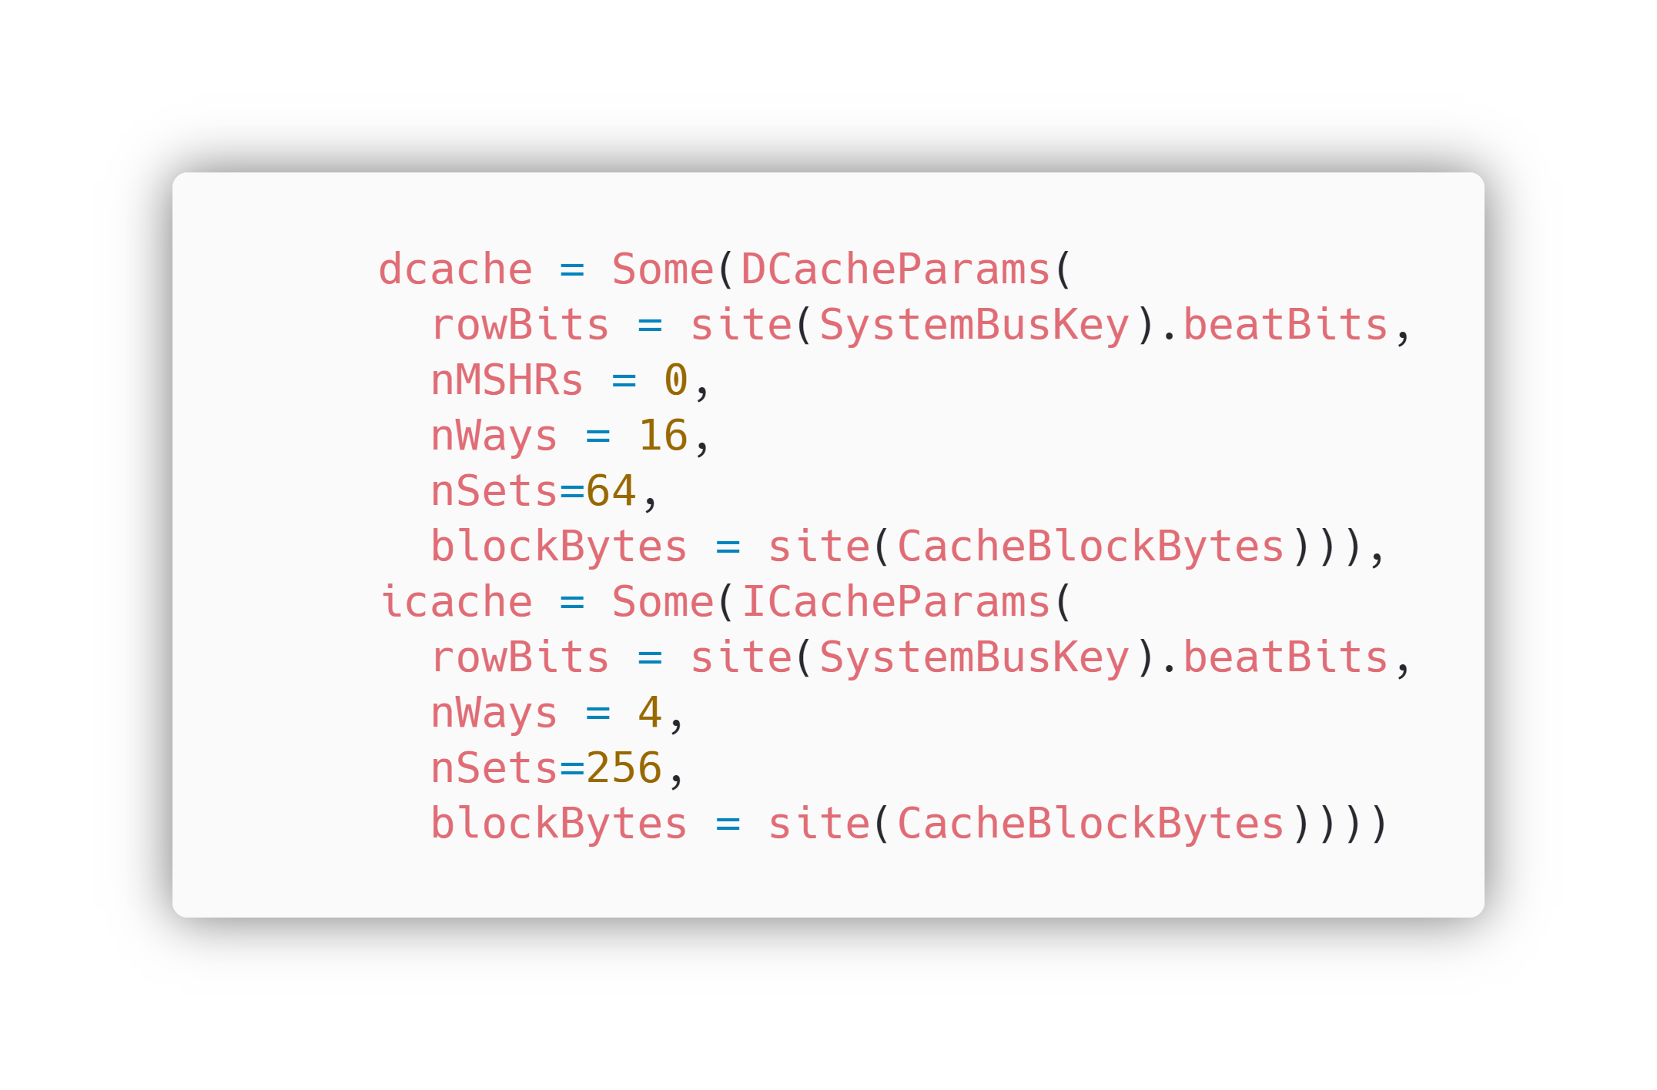
Configuring the icache and dcache
dcache has DCacheParams, which are parameters for configuring Data Cache. Similarly, icache has ICacheParams, which are parameters for configuring Instruction Cache.

Slide 29
Data Cache Parameters
Parameters | Value | Description
nMSHRs | 0 | There are 0 MSHRs (Miss Status Handling Registers) in Instruction Cache
nWays | 16 | There are 16 Ways of Cache in DCache
nSets | 64 | There are 64 Sets of Cache in DCache
blockBytes | 64 (evaluated) | There are 64 blockBytes in DCache
Size of DCache is calculated by: nWays x nSets x blockBytes (16 x 64 x 64 == 64KB)
Instruction Cache Parameters
Parameters | Value | Description
nWays | 4 | There are 4 Ways of Cache in ICache
nSets | 256 | There are 256 Sets of Cache in ICache
blockBytes | 64 (evaluated) | There are 64 blockBytes in ICache
Size of ICache is calculated by: nWays x nSets x blockBytes (4 x 256 x 64 == 64KB)

Slide 30
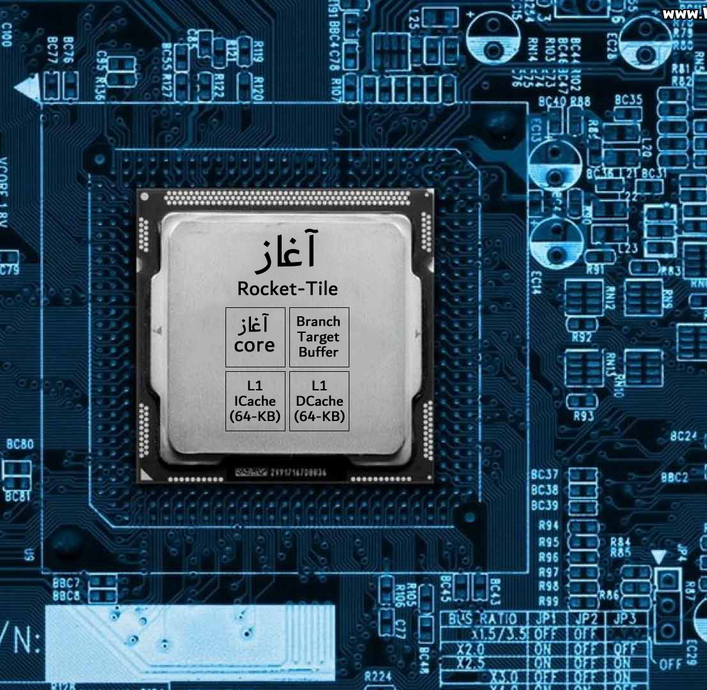
Blocks of Tile
Rocket-Tile of Aghaz SoC contains Aghaz Core, Branch Target Buffer, Page Table Walker, L1 Icache & DCache of 64-KB, and Sratchpad

Slide 31
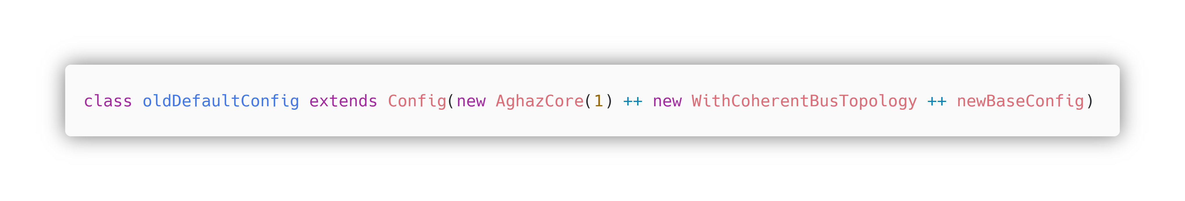
Adding AghazCore to Default Configuration
In oldDefaultConfig, AghazCore is added with a bus topology (WithCoherentBusTopology) and Base Configuration (BaseConfig)
Since Rocket-Chip by default generates 64-bit SoCs, so at this point our AghazCore will also be of 64-bit Configuration.

Slide 32
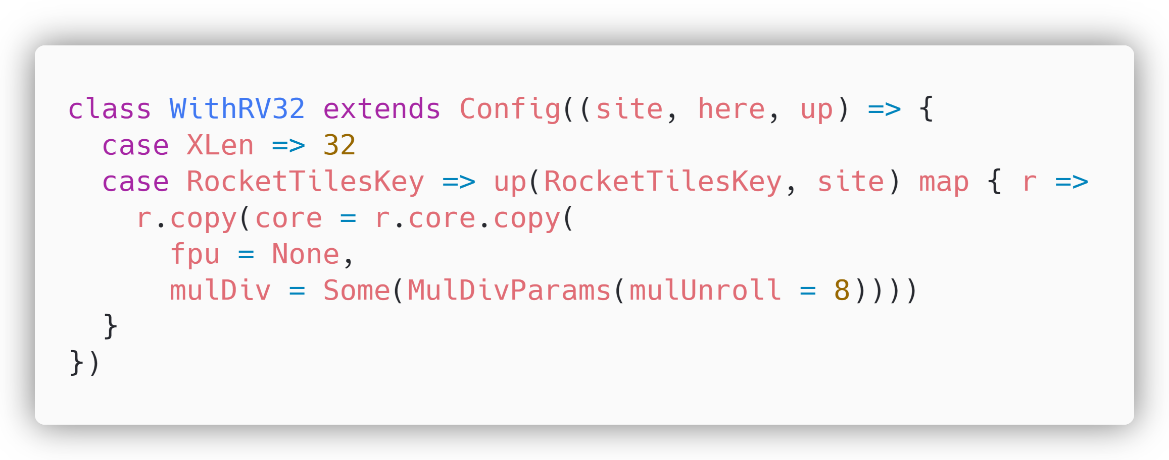
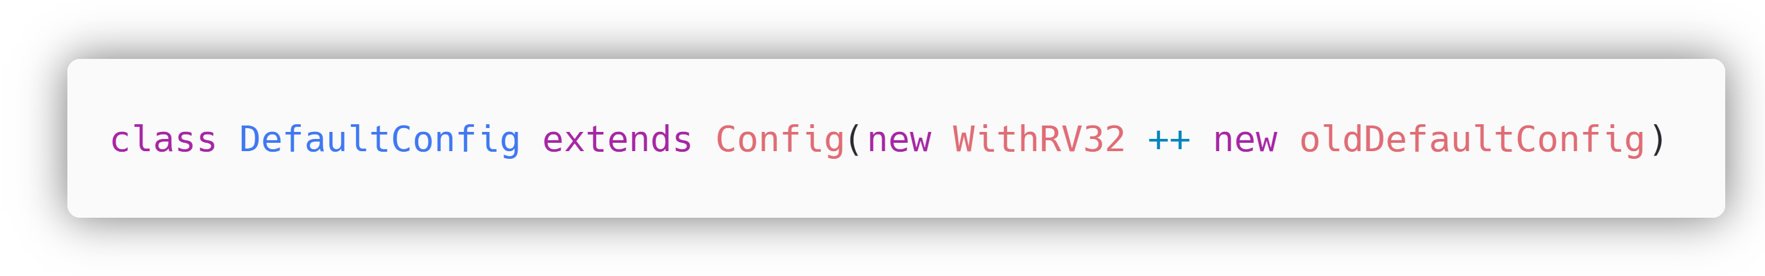
Configuring 32-bit Configuration
Configuring AghazCore to 32-bit Configuration

Slide 33

Blocks of SoC

Slide 34
At this point our Aghaz SoC is successfully configured and ready to be built.

Slide 35
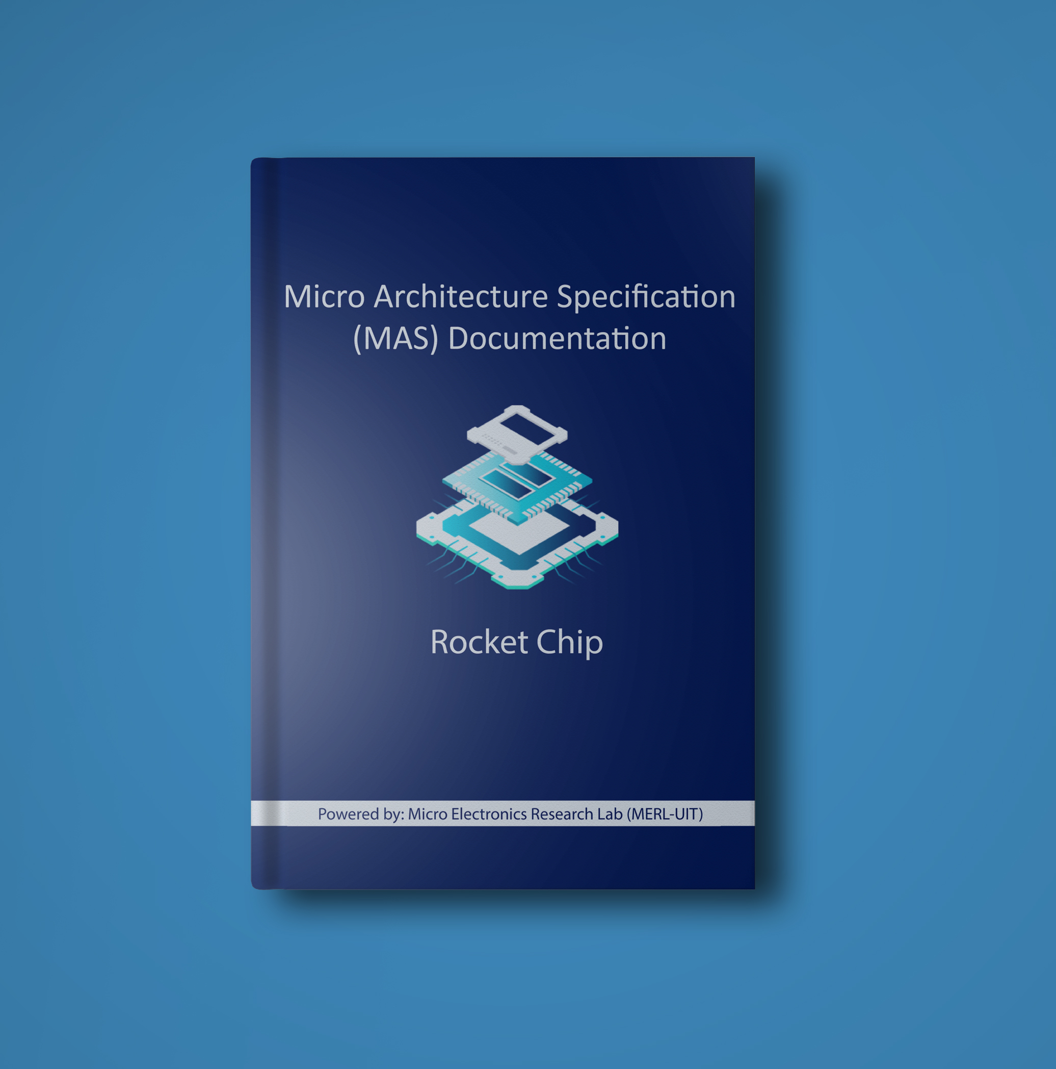
Configuring an SoC to your Requirements is a 2 minutes process by means of this MAS Document

Slide 36
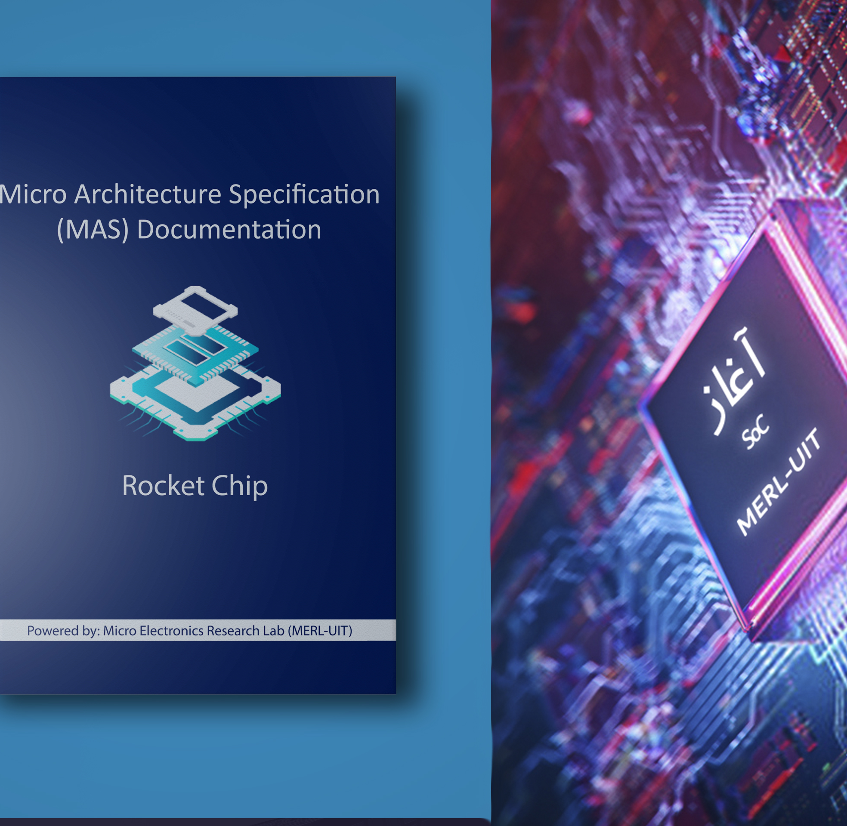
Acknowledgements This Document was made possible with the counselling, guidance and support of Dr.Roomi Naqvi, Dr Ali Ahmed Ansari, and Farhan Ahmed Karim. Without their encouragement and guidance, this could not be possible in any way. This Document was created under the Lead of Uzair Khan. along with the team of collaborators/ interns under him that gave their level best under the supervision of such experienced mentors.
Team Members
Waleed Waseem
Shahzaib Kashif
Talha Ahmed
Mohsin Raza
Muhammad Shahzaib
Syeda Fizza Jaffery
Almas Ibrahim
Ubab Nadeem

Slide 37
December 8-10 | Virtual Event
Thank you for joining us.
Contribute to the RISC-V conversation on social!
#RISCVSUMMIT @risc_v

Slide 38
https://docs.boom-core.org/en/latest/sections/intro-overview/rocket-chip.html

